Slide 1
Network Communication
Introduction to Python for Security

Slide 2
Course Path
Introduction to Python for Security
Introduction to Programming
Data Types & Conditions
Loops
File System & Error Handling
Python for Security
Network Communication
Functions

Slide 3
Objectives
Network Communication
This lesson focuses on how Python is used for network communication, how sockets are created via Python, and how Python facilitates communication with servers.
Creating a Server Socket
Creating a Client Socket
Sending Data
Echo Communication

Slide 4
Creating a Server Socket
Network Communication

Slide 5

Sockets
Creating a Server Socket
The endpoint of a connection between two communicating parties
Consists of an IP address, communication protocol, and port
Notes:
Explain what socket modules are used for.
Python sockets can be used by attackers to create malicious code that acts as a reverse shell from the client to the attacker (listener).
Mention that to work with Python sockets, the socket library needs to be imported.

Slide 6
Import Socket Library
Creating a Server Socket
import socket
The socket library is part of Python’s standard library.
The library allows creation of sockets for connection and listening purposes.
The library includes many functions and variables.
Notes:
Demonstrate how to import the socket module and show its contents using the dir() command.

Slide 7
Creating a Socket – Server Side
Creating a Server Socket
import socket
new_socket = socket.socket()
To create a new socket, the socket library must first be imported.
The library includes a method called socket that accepts two variables.
Notes:
Explain the parameters that the method can accept. Point out that the method’s parameters have the default values AF_INET and SOCK_STREAM.

Slide 8
Setting a Server IP Address and Port
Creating a Server Socket
import socket new_socket = socket.socket() new_socket.bind(("0.0.0.0", 50000))
The socket requires binding to an IP and port.
The information is passed as a tuple.
Without the binding, the socket will not be able to accept connections.
Notes:
Demonstrate how to use bind with a specific IP and explain address 0.0.0.0, which listens for all interfaces. Point out that the IP address is a string, and the port is an integer. Note that since a server waits for clients to connect, client IPs are not known beforehand.

Slide 9
Server Connection Limit
Creating a Server Socket
import socket new_socket = socket.socket() new_socket.bind(("0.0.0.0", 50000)) new_socket.listen(4)
A connection amount limitation can be set.
The number of connections is represented by an integer.
The amount of allowed connections must be carefully considered.
Notes:
Emphasize that the user can specify any number of connections in the listen() function.
Once an IP address and port are set, the next step is to set the number of connections the server can receive. Since it may be difficult for learners to understand the socket creation steps at this point, you can build the socket with comments for now and continue with the lesson.

Slide 10
Accepting Connections
Creating a Server Socket
import socket new_socket = socket.socket() new_socket.bind(("0.0.0.0", 50000)) new_socket.listen(4) conn, addr = new_socket.accept() new_socket.close()
Two objects are returned when a connection is accepted: a socket and an IP address.
A connection should be closed when the communication ends.
Notes:
Explain how the returned data from accept() is saved in variables and used later to send and receive information. In the example, conn is used to get socket connection details that can be relayed. addr is used to get the client IP and port. Explain that this is how a simple server-side socket is written in Python.

Slide 11
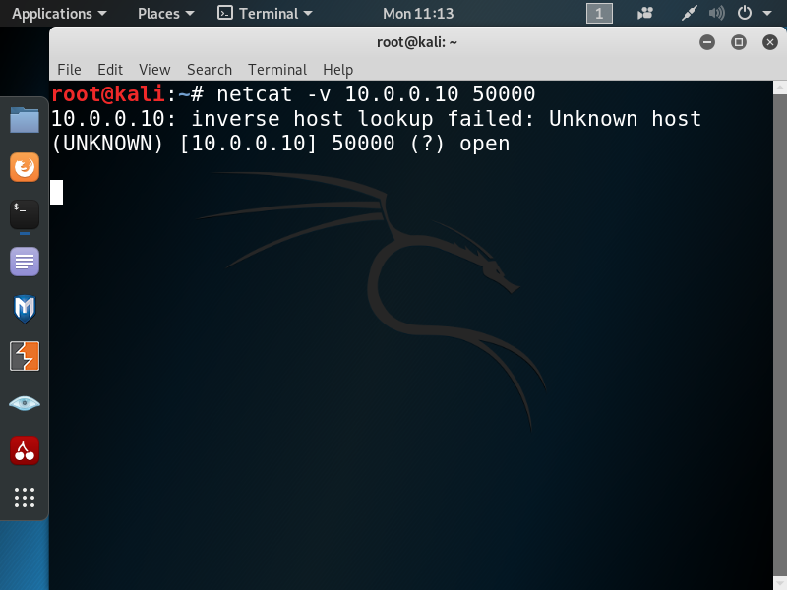
Connection Check
Creating a Server Socket
Each new socket should be tested.
The netcat tool can be used to test the connection.
The tool acts as a client connected to the server.
Notes:
Explain that we are now running netcat on the client side and will try to connect to our server. Since the server will accept connections from any interface, no special configuration is required. In the next slide, we will use netcat to connect to the server and test it. Demonstrate the nc –v command and explain it. Use nc –v [server ip] [port] to test the connection and verify that the server is configured properly. If the socket server was not configured to send data, netcat will accept the connection and then close it.
Example:
Create a socket in PyCharm that will accept all IP addresses on port 3434. Open Linux and run netcat to connect to your socket. Check the connection.

Slide 12
Creating a Client Socket
Network Communication

Slide 13
Creating a Socket: Client Side
Creating a Server Socket
import socket new_socket = socket.socket()
The first steps are similar to the server side.
The library is imported, and the object is created.

Slide 14
Establishing a Connection
Creating a Server Socket
import socket new_socket = socket.socket() new_socket.connect(("10.0.0.5", 50000))
new_socket.close()
Next, the client needs to establish a connection.
The connection requires parameters similar to the binding.
Just like with the server side, the connection must be closed when communication ends.
Notes:
Demonstrate how to use the connect() function. Point out that the IP address will be the target of the socket (the IP address to connect to). The port will be the port of the target server to which the user wants to connect.

Slide 15
Connection Error Handling
Creating a Server Socket
import socket new_socket = socket.socket() try: new_socket.connect(("10.0.0.5", 50000)) except: print("The connection was refused") new_socket.close()
A client cannot connect to a non-existing server.
If it tries, an exception will be raised, and the program will be terminated.
The error can be handled by a try & except block.
Notes:
Explain that it is essential to keep the program’s operational flow by handling potential errors. Point out that the potential exception is ConnectionRefusedError.

Slide 16
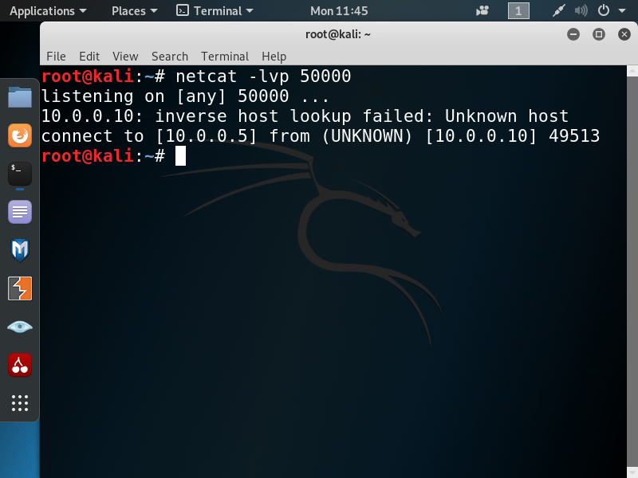
Client to netcat: netcat Side
Creating a Client Socket
netcat can also act as a server to test clients.
It is configured to listen to incoming connections.
Notes:
Demonstrate how to run nc –lvp and explain the command. Note that netcat needs to be enabled and the client IP address must be set to the target netcat machine. Run nc –lvp [port] to establish a listener. The client socket will be operational when netcat receives the connection.
Example:
Set a socket to a loopback IP on port 4444 via netcat. Set a netcat listener and check the response when a client socket is established.

Slide 17
Lab PY-06-L1
Creating a Client Socket
Implement the required commands to create a client connection to a listening server.
What Are Sockets?
30–45 Min.
Sign into the TDX Arena platform.
Navigate to the Practice Arena.
Navigate to the Python Programming course.
Select the PY04 Network Programming module.
Select the What Are Sockets? lab.
Computer
Internet connection
Web browser
TDX Arena access
Python Course Textbook
Chapter 6, Section 1 & 2

Slide 18
Sending Data
Network Communication

Slide 19
How Data Is Sent
Sending Data
import socket new_socket = socket.socket() new_socket.connect(("10.0.0.5", 50000)) new_socket.send("Hello from the other side".encode()) new_socket.close()
Data sent between a client and server must be encoded.
Encoding is required because a socket can only accept bytes.
Notes:
Demonstrate how to use the send() function. Explain the encode() method and the need for data to be in byte form for it to be sent.

Slide 20
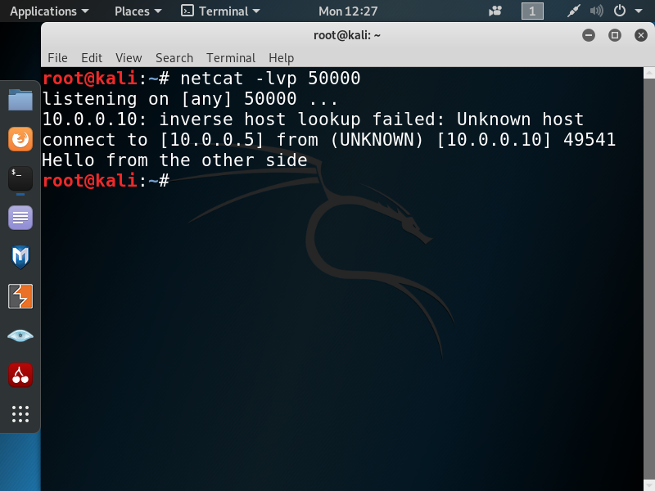
Sending Data to netcat
Sending Data
The netcat server decodes the message.
netcat accepts a connection and then prints the client’s message.
Notes:
Explain the decode() function performed by netcat. Note that in the example, netcat gets the message and closes the connection.
Example:
Create a client socket in PyCharm that sends the following data: “Hello, I'm a client who is sending you data.”
Create a netcat listener that will receive the data. Check the data.

Slide 21
Receiving Data: Server Side
Sending Data
import socket new_socket = socket.socket() new_socket.bind((“0.0.0.0", 50000)) new_socket.listen(4) conn, addr = new_socket.accept() data = conn.recv(2048).decode() print(data) new_socket.close()
----------------------------------------------------------
Hello from the other side
Process finished with exit code 0
Python’s socket can also accept data from a client.
A byte limitation (buffer) needs to be set for all data received.
The accepted data must be decoded to get the human-readable representation.
Notes:
Demonstrate how to use the recv() function. Explain its main purpose and buffers.
Explain how recv() is used in a while loop.

Slide 22
Receiving Data: Client Side
Sending Data
import socket new_socket = socket.socket() new_socket.connect((“10.0.0.5", 50000)) data = new_socket.recv(2048).decode() print(data) new_socket.close()
----------------------------------------------------------
Hello from server
Process finished with exit code 0
A server typically also sends data to clients.
Clients receive the data similarly to how the server receives data.
Notes:
Review the decode() function again and make sure learners understand it. Review recv() and buffers again and make sure learners understand them. Point out that the data receiving process for the client is the same as that for the server.

Slide 23
Sending Large Data
Sending Data
import socket try: mysocket = socket.socket()
mysocket.bind(("0.0.0.0", 1334))
mysocket.listen(1)
c, addr = mysocket.accept()
buffer = 5
data = ""
while True: packet = c.recv(buffer)
parsed = packet.decode()
data += parsed
if len(packet) < buffer:
print("All the data has been received successfully.")
print("Full data -> {}".format(data)) break
===================================================================================
<Output in here>
All the data has been received successfully.
Full data -> Hello, I’m the client.
Process finished with exit code 0
===================================================================================
Data sent to the server is limited to 2,048 bytes.
If a message is more than 2,048 bytes, it will be divided into smaller parts.
A packet length of less than 2,048 means all the data was transferred.
Notes:
Explain the condition that checks if a message is longer than the buffer size. If the message is longer, the condition splits it into smaller groups. If it is less than the buffer size, it is sent as is. Using an if condition, the code can check the package size and notify when the data is transferred. Since the data was encoded, it needs to be decoded on the server side.
Example:
Build a client-side socket that will send “Hello, I'm a client.” Build a server-side socket that will get the data and check the buffer. Have the socket print the message accordingly. If the information exceeds the size of the buffer’s limit, notify the user that there is still information on the way and then print it again. When the complete information arrives, print a notification. For POC, create a string that is larger than the buffer size, send it to the server, and check the server’s response.

Slide 24
Lab PY-06-L2
Sending Data
Write code that will communicate with a server to exchange data.
Network Protocol Communications
15–25 Min.
Sign into the TDX Arena platform.
Navigate to the Practice Arena.
Navigate to the Python Programming course.
Select PY04 Network Programming.
Select the Network Protocol Communications lab.
Computer
Internet connection
Web browser
TDX Arena access
Python Course Textbook
Chapter 6, Section 3

Slide 25
Echo Communication
Network Communication

Slide 26
Echo Server Communication
Echo Communication
import socket
try:
mysocket = socket.socket()
mysocket.bind(('0.0.0.0’, 50000))
mysocket.listen(1)
print("waiting for connection...")
c, addr = mysocket.accept()
print("client that connected details are -> {}".format(addr))
while True:
sendData = input("message to client : ")
c.send(sendData.encode())
if sendData == "exit":
c.close()
break
rcvData = c.recv(1024).decode()
print("message from client : {}".format(rcvData))
if rcvData == "exit":
print("connection as closed by user".encode())
c.close()
break
except Exception as e:
print(e)
A chat can be established between the client and server.
while true will run as long as a connection is active.
The response will be displayed on the console.
Notes:
The server will send a message and wait for a response from the client. The if condition in the example checks if the client sent an exit message. If so, it closes the connection and breaks the loop. Note the hierarchy between the client and the server. If the server sends information to the client first, the client should receive it and only then send information back.

Slide 27
Echo Client Communication
Echo Communication
import socket
try:
mysocket = socket.socket()
mysocket.connect(('127.0.0.1’, 50000))
print("connection establish...")
while True:
serverData = mysocket.recv(2048).decode()
print("message from server : {}".format(serverData))
if serverData == "exit":
print("connection as closed by server")
mysocket.close()
break
sendData = input("message to server : ")
mysocket.send(sendData.encode())
if sendData == "exit":
print("connection as closed by client")
mysocket.close()
break
except Exception as e:
print(e)
The client connects to the IP address of the server.
When a connection is established, the server sends data to the client.
When the client gets the data, it sends data back to the server.
Notes:
Demonstrate how to use loops to send and receive data between the client and server.
If there is a connection, the client will wait for a message from the server and will then send a response to the server. The if condition in the example checks if the client sent exit, or the data received from the server was exit. If so, the client closes the connection and breaks the loop.
Example:
Build a chat between a client and server. Make sure everything is working properly.
When one side sends exit or bye, note that both sides will close the connection.
Use a socket to gather information:
When a client sends ifconfig or ipconfig to the server (depending on the OS system), the server will execute the command and send the output back to client. Hint: You will need to increase the buffer’s limit via the OS module.

Slide 28
TDX Arena Challenge
Echo Communication
Study the logic of the site and automate the process.
Sign into the TDX Arena platform.
Navigate to the Challenges Arena.
Under Explore More, select the Search icon.
In the search field, type fire.
Select the Fireflies challenge.
Then, complete the steps below:
Understand the site logic.
Write a script to automate the process.
Fireflies
Notes:
TDX Arena challenges can be done at home for extra practice. Make sure learners remember how to log in. Mention that the TDX Arena guide is provided in the course’s LMS shell.

Slide 29
Questions?
Thank You
©️ 2021 HackerUSA Inc. d/b/a ThriveDX

